Slide 1
The Arkansas BEAD Program
Infrastructure Roundtable - Technical Assistance
Friday, February 14, 2025

Slide 2
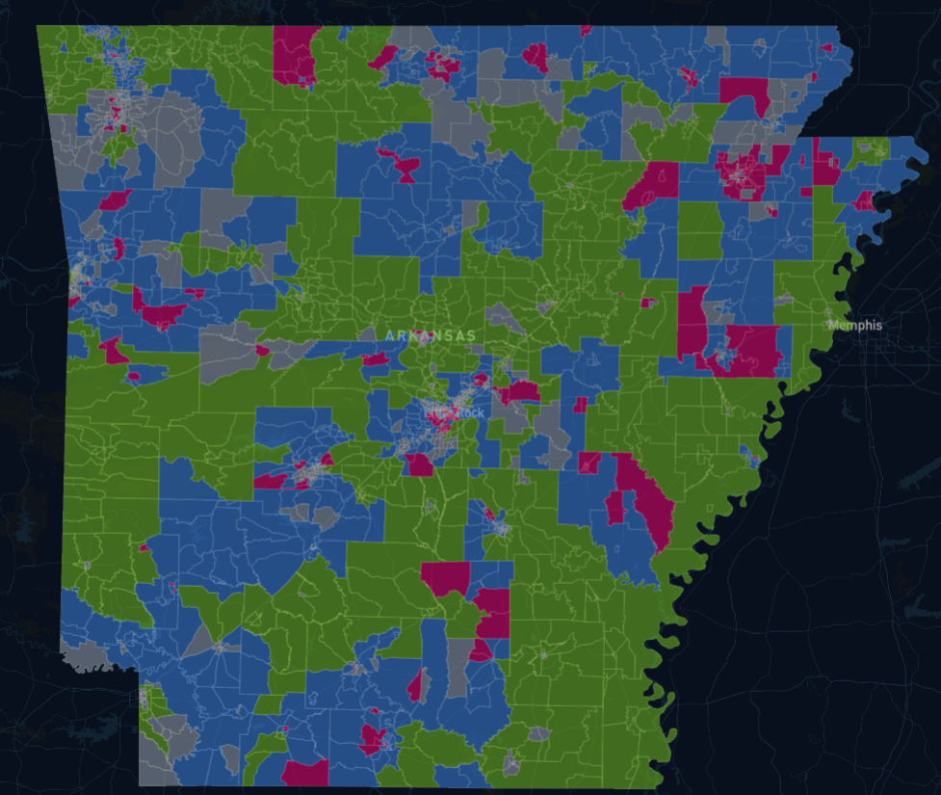
Recall | Once in the applicant portal, applicants will be able to see a map displaying each CBG's availability as a result of Tranche-1 adjudication
Map of Tranche-1 Results
CBG statuses after Tranche-1
Preliminarily Selected (unavailable)
CBGs that were preliminarily selected in Tranche-1 and are no longer available for bidding
Available Zero Bid
Applicants will be allowed to add these areas to Carried Forward or new bids for additional points. These CBGs do not need to follow contiguity rules
Available
CBGs that received bids in Tranche-1, but no winner was determined. These CBGs must follow contiguity rules
Ineligible
CBGs that contain 100% served locations and are unavailable for bidding
Preliminarily Selected
Available Zero-bid
Available
Ineligible

Slide 3
Recall | A CBG can be classified as a Zero Bid CBG in three different ways
 | True zero bid These CBGs were not included in any Tranche-1 applications
 | Competitive closed bids These CBGs belong to competitive bids that partially overlapped with a Buy It Now bid, and therefore were closed
 | Non-competitive carried forward bids These CBGs belong to carried forward bids that did not overlap with any other applications, but did not meet Buy It Now criteria
1
2
3
Note | This means it is possible for a CBG included in your applications(s) to be classified as an "Available Zero Bid"

Slide 4
For Tranche-2, Reference Prices of Zero Bid CBGs were increased relative to the level of interest and competition they received in Tranche-1
Zero Bid CBG Category | Description | Ref Price Multiple | Impacted CBGs
0 bids | CBGs that received no bids in Tranche-1 | 2x | 266
1 bid (Closed) | CBGs that received 1 bid in Tranche-1 which was closed | 1.5x | 161
2+ bids (Closed) OR 1 bid (Carried Forward) | CBGs that received multiple bids in Tranche-1 which were closed OR CBGs that received 1 bid in Tranche-1 which was carried forward | 1.2x | 203
Note | Adjusted Reference Prices for Zero Bid CBGs not to exceed $50k per location

Slide 5
The updated Reference Price document lists all 1,291 CBGs available in Tranche-2, including their status, Reference Price, and increase indicator
Tranche-2 Reference Prices
List of CBGs available in Tranche-2
CBGs status as either "Available" or "Available Zero Bid"
Indicator of an increased Reference Price
Note | Adjusted Reference Prices for Zero Bid CBGs do not exceed $50k per location; therefore, it is possible for an Available Zero Bid to not receive a reference price increase

