Slide 1
The Arkansas BEAD Program
Wednesday Webinar - Technical Assistance
Wednesday, April 2, 2025

Slide 2
Accessing Tranche-2 Results

Slide 3
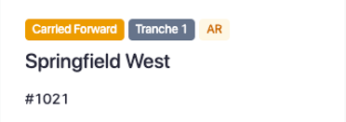
Applicants should have received an email on Tuesday, April 1 that Tranche-2 bid results were published in the Grantor Portal
Explanation of Tranche-2 bid results
Tranche 2
Selected
Tranche 2
ISP Name
 | Preliminarily Selected Winning bids as a result of the Tranche-2 rules of adjudication and NTIA requirements
 | Partial Award Eligible Bids that were not selected as a result of Tranche-2 rules of adjudication and/or federal requirements, but were the sole bidder on a residual CBG
 | Not Selected Bids that were not selected as a result of Tranche-2 rules of adjudication and/or federal requirements
Application #
Each of your Tranche-2 applications will be classified as one of 3 possible outcomes: Preliminarily Selected, Partial Award Eligible, or Not Selected
An explanation of each classification can be found in the email notification
Additionally, applicants were provided with important reminders and disclaimers
Applicant portal
Email notification
Recall | All Tranche-2 results are preliminary and may not be shared publicly or with other applicants

Slide 4
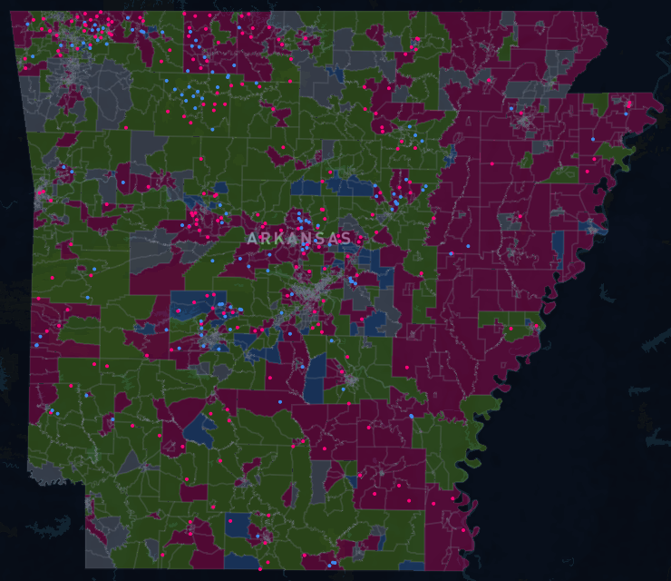
Once in the applicant portal, applicants will also be able to see a map displaying each CBG's availability as a result of Tranche-2 adjudication
Map of Tranche-2 CBG results
CBG statuses following Tranche-2
Preliminarily Selected (unavailable)
CBGs that were preliminarily selected in T1 or T2 and are no longer available for bidding
Available Partial Award Eligible
CBGs that received bids in Tranche-2 but were not preliminarily selected and will be offered at prorated subsidies to their sole bidders
Available
CBGs that will be available for bidding in Tranche-3
Ineligible
CBGs that contain 100% served locations and are unavailable for bidding
Note | This map will be updated once more prior to Tranche-3, following the Partial Award Eligible outreach process

Slide 5
Negotiations | Partial Award Eligible outreach

Slide 6
Recall | Overview of ARConnect's approach to achieving 100% coverage
We are here
Focus of today's session
Close Tranche-2
Score and adjudicate
Announce and communicate preliminary results
Partial Award Eligible Outreach
Contact sole bidders on partial award eligible CBGs
Offer prorated subsidies
Tranche-3
Final Tranche of bidding for all remaining CBGs
Open to all pre-registrants
Alternative technology eligible for selection
Negotiation milestones
ULFW Claims Window
Contact ULFW providers that have capacity to deliver service meeting the BEAD Program's technical requirements
7-day window
ULFW Evidence Window
Request evidence for claimed ULFW locations
30-day window
ULFW Determination
Evaluate ULFW evidence
Remove from alt-tech projects any locations sufficiently claimed by ULFW
ULFW Claims Process
Per NTIA guidance, before selecting alternative technology subgrantees, eligible entities must identify any BSLs in the project area already served by an ULFW provider that has the capacity to deliver service meeting the BEAD program's technical requirements¹
1. BEAD Program: Alternative Broadband Technology Policy Notice

Slide 7
Recall | Possible outcomes for partial award eligible CBGs
PAE CBG outcomes
Deconfliction example
From IPvII "Losers of adjudication after Tranche-2 may be eligible for parts of their proposed project areas that did not overlap with any other bids. If this is the case, they will be invited to accept prorated subsidies for these non-competitive areas"¹
Non-competitive PAE CBGs ARConnect will directly contact applicants and offer a prorated amount for their non-competitive PAE CBGs If offer is accepted, then the CBG(s) will be preliminarily selected for that applicant If offer is rejected, then the CBG(s) will be available in Tranche-3
Competitive PAE CBGs Competitive residual CBGs (i.e., CBGs that do not belong to selected bids, but were included in bids from multiple ISPs) will be available in Tranche-3
1 | 2 | 3
4 | 5 | 6
7 | 8 | 9
Direct outreach
Tranche-3
Direct outreach
Selected
Selected
Blue bid on CBGs 5 and 8 and was Selected
Green bid on CBGs 1, 2, and 5 and lost; Yellow bid on CBGs 2, 3, and 5 and lost:
CBG 5 and 8 belong to Blue
CBG 2 was competitive and will be available in T3
ARConnect will negotiate with Green for CBG 1 and with Yellow for CBG 3, respectively
If either offer is declined, those CBGs will be available in Tranche-3
Note | For this process, a "competitive" PAE CBG is defined as a CBG that received bids from more than 1 applicant; if a PAE CBG received multiple bids from only 1 applicant, it will be considered "non-competitive" and will be eligible for this process
1. IPvII, 2.4.1, pg. 15

Slide 8
Recall | Methodology for prorating partial award offers
Pro-rate methodology
Share of Reference Price example
Share of Reference Price Prorated subsidies will be calculated on a proportional basis using the total Reference Price of the proposed project area
Restrictions Bids that contain alternative technology or requested more than 2x Reference Price will be ineligible for this process
CBG ID | Requested subsidy | Reference Price | % of total Reference Price
1 | N/A | $2,000 | 20%
2 | N/A | $3,000 | 30%
3 | N/A | $4,000 | 40%
4 | N/A | $1,000 | 10%
Total | $14,000 | $10,000 | 100%
1
A bid was submitted for 4 CBGs and a total requested subsidy of $14,000; the cumulative reference price was $10,000
2
The bid lost CBGs 2 and 3 to a Selected bid and overlaps with another losing bid in CBG 4; it is the sole bidder for CBG 1
3
The losing bid's non-competitive residual CBG (CBG 1) accounted for 20% of the original project area's total reference price
4
State offers ISP 20% of original requested subsidy for the residual CBG: $14,000 * 20% = $2,800
Note | The communication of partial award offers will take place in the applicant portal utilizing the "revision request" feature

Slide 9
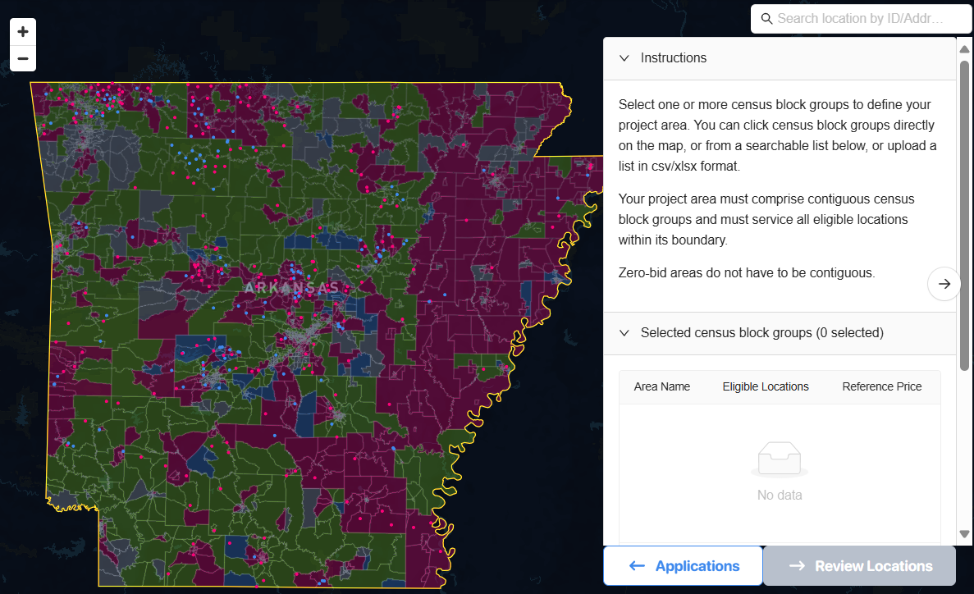
PAE outreach | To accept prorated offer, follow 3-step process by 6pm CT April 10
Step 1: Modify project area
Step 2: Modify subsidy request
Revision request message
This bid is eligible for a partial award for the following CBGs: [list of CBG IDs]
ARConnect is offering a prorated amount of [$x] to serve all locations in the listed CBG(s). Note that counteroffers will not be accepted
To accept this offer, please complete Steps 2 and 3 of a 3-step process:
Step 2 – In this section, modify the requested subsidy in Question 6 to the exact amount listed above
Step 3 – After completing Steps 1 and 2, select “Submit” by 6pm CT on April 10 to formally accept the prorated amount for the listed CBG(s)
If you do not wish to accept this offer, no action is required. If no action is taken by 6pm CT on April 10, the offer is considered declined, and the CBG(s) will be available for bidding in Tranche-3
Revision request message
This bid is eligible for a partial award for the following CBGs: [list of CBG IDs]
ARConnect is offering a prorated amount of [$x] to serve all locations in the listed CBG(s). Note that counteroffers will not be accepted
To accept this offer, please complete Step 1 of a 3-step process:
Step 1 – In this section, modify the project area to only include the CBG(s) listed above
If you do not wish to accept this offer, no action is required. If no action is taken by 6pm CT on April 10, the offer is considered declined, and the CBG(s) will be available for bidding in Tranche-3
Step 3: Resubmit application

