Slide 1
The Arkansas BEAD Program
Infrastructure Roundtable - Technical Assistance
April 11, 2025

Slide 2
Recall | Overview of ARConnect's approach to achieving 100% coverage
Focus of today's session
Close Tranche-2
Score and adjudicate
Announce and communicate preliminary results
Partial Award Eligible Outreach
Contact sole bidders on partial award eligible CBGs
Offer prorated subsidies
Tranche-3
Final Tranche of bidding for all remaining CBGs
Open to all pre-registrants
Alternative technology eligible for selection
Negotiation milestones
We are here
ULFW Claims Window
Contact ULFW providers that have capacity to deliver service meeting the BEAD Program's technical requirements
7-day window
ULFW Evidence Window
Request evidence for claimed ULFW locations
30-day window
ULFW Determination
Evaluate ULFW evidence
Remove from alt-tech projects any locations sufficiently claimed by ULFW
ULFW Claims Process
Per NTIA guidance, before selecting alternative technology subgrantees, eligible entities must identify any BSLs in the project area already served by an ULFW provider that has the capacity to deliver service meeting the BEAD program's technical requirements¹
1. BEAD Program: Alternative Broadband Technology Policy Notice
Notes:
Hi everyone, good morning
We are moving right along through our approach to achieving 100% coverage, which is the period we have been referring to as negotiations.
If you recall, during negotiations, there are three key milestones, which you can see at the top of the page here.
This starts with closing out Tranche-2 and then reaching out directly to ISPs who are the sole bidders on partial award eligible CBGs to offer prorated subsidies for those CBGs
The partial award eligible process concluded last night, so we are currently in the interim period between the conclusion of the partial award eligible process and the opening of the Tranche-3 application window
As it is the next step and is tentatively scheduled to open some time next week, I wanted to spend our time today reviewing the rules of Tranche-3
- NEXT

Slide 3
Agenda
Agenda
 | What are the application submission rules for Tranche-3?
 | What CBGs are available for bidding in Tranche-3?
 | How will applications be preliminarily selected in Tranche-3?
 | Resources and reminders
1
2
3
4
Notes:
For today's review, the goal is to answer 3 key questions:
What are the application submission rules for Tranche-3?
What CBGs are available for bidding in Tranche-3?
And how will applications be preliminarily selected in Tranche-3?
NEXT

Slide 4
Agenda
Agenda
 | What are the application submission rules for Tranche-3?
 | What CBGs are available for bidding in Tranche-3?
 | How will applications be preliminarily selected in Tranche-3?
 | Resources and reminders
1
2
3
4
Notes:
So let's start with question 1: what are the application submission rules for Tranche-3?
NEXT

Slide 5
Key application submission rules for Tranche-3
Tranche-3 application questions | Tranche-3 application rules
Who can participate? | All successfully pre-registered providers can participate
What types of bids are there? | New bids only
What are the possible outcomes for bids? | Preliminarily Selected or Not Selected (i.e., Closed)
How many CBGs can be included in a project area? | Project area size of 1 CBG with the exception of "donut" CBGs
How many times can an applicant bid on a particular CBG? | An applicant can bid on a particular CBG up to 3 times
Are there any subsidy thresholds? | There are no subsidy thresholds; however, subsidy request is still the largest portion of a bid's score
Which technology types are eligible for selection? | All technology types are eligible for selection, including Alternative
How many points are available? | 95 points are available as the zero-bid criteria will not be scored
How long is the application window, and when will it open? | 7-day application window tentatively scheduled to open next week
Notes:
When it comes to the rules for submitting an application in Tranche-3, I thought it would be easiest to address them in the form of question and answer
So we will cover the most pressing questions when it comes to submitting an application in Tranche3
Who can participate?
All successfully pre-registered providers can participate
What types of bids are there?
New bids only – Tranche-3 is a "clean slate"
What are the possible outcomes for bids?
Preliminarily Selected or Not Selected (i.e., Closed)
How many CBGs can be included in a project area?
Project areas can only consist of 1 CBG with the exception of "donut" CBGs, where a CBG sits inside of another
How many times can an applicant bid on a particular CBG?
An applicant can bid on a particular CBG up to 3 times
Are there any subsidy thresholds?
There are no subsidy thresholds in Tranche-3; however, the subsidy request is still the largest portion of a bid's score
Which technology types are eligible for selection?
All technology types are eligible for selection, including Alternative technology
How many points are available?
There are 95 points available as the zero-bid criteria will not be scored
How long is the application window, and when will it open?
7-day application window tentatively scheduled to open next week

Slide 6
Agenda
Agenda
 | What are the application submission rules for Tranche-3?
 | What CBGs are available for bidding in Tranche-3?
 | How will applications be preliminarily selected in Tranche-3?
 | Resources and reminders
1
2
3
4
Notes:
Next question to address is what CBGs are available for bidding in Tranche-3?
NEXT

Slide 7
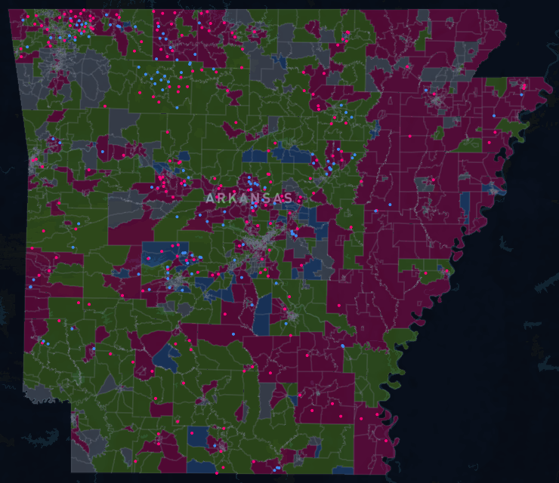
Prior to opening Tranche-3, the CBG claims map will be updated to reflect the outcomes of the Partial Award Eligible Process and any rescinded selections
Map of Tranche-2 CBG results
CBG statuses following Tranche-2
Preliminarily Selected (unavailable)
CBGs that were preliminarily selected in T1 or T2 and are no longer available for bidding
Available Partial Award Eligible
CBGs that received bids in Tranche-2 but were not preliminarily selected and will be offered at prorated subsidies to their sole bidders
Available
CBGs that will be available for bidding in Tranche-3
Ineligible
CBGs that contain 100% served locations and are unavailable for bidding
Note | All CBGs currently labelled as Available Partial Award Eligible will either be shown as Available or Preliminarily Selected
Note | If a Preliminarily Selected bid from Tranche-1 or Tranche-2 was rescinded prior to Tranche-3, its CBGs will be shown as Available
Notes:
So, as I am sure you are all aware, the results of Tranche-2 have been posted in the applicant portal and the CBG claims map, which displays the current status of each CBG in the State.
Currently, CBGs have one of four possible statuses:
So you have CBGs that were preliminarily selected in Tranche-1 or Tranche-2, which means they are no longer available for bidding in Tranche-3
Available partial award eligible CBGs, which were offered at a prorated subsidy to their sole bidders through the partial award eligible process
Available CBGs, which are those that will be available for Tranche-3
And Ineligible CBGs, which are those that contain 100% served locations and are therefore unavailable for bidding
However, this map will be updated once more prior to Tranche-3 to reflect the results of the Partial Award Eligible process, which concluded yesterday, as well as any selections from Tranche-1 or Tranche-2 that have been rescinded
What that means is that all CBGs currently labelled as "available partial award eligible" - so the ones - will either be shown as "available" or "preliminarily selected", and it is possible that CBGs previously shown as "Selected" will now be "available" if they belonged to a rescinded bid
NEXT

Slide 8
Agenda
Agenda
 | What are the application submission rules for Tranche-3?
 | What CBGs are available for bidding in Tranche-3?
 | How will applications be preliminarily selected in Tranche-3?
 | Resources and reminders
1
2
3
4
Notes:
Now let's address our final questions, which is: how will applications be preliminarily selected in Tranche-3?
NEXT

Slide 9
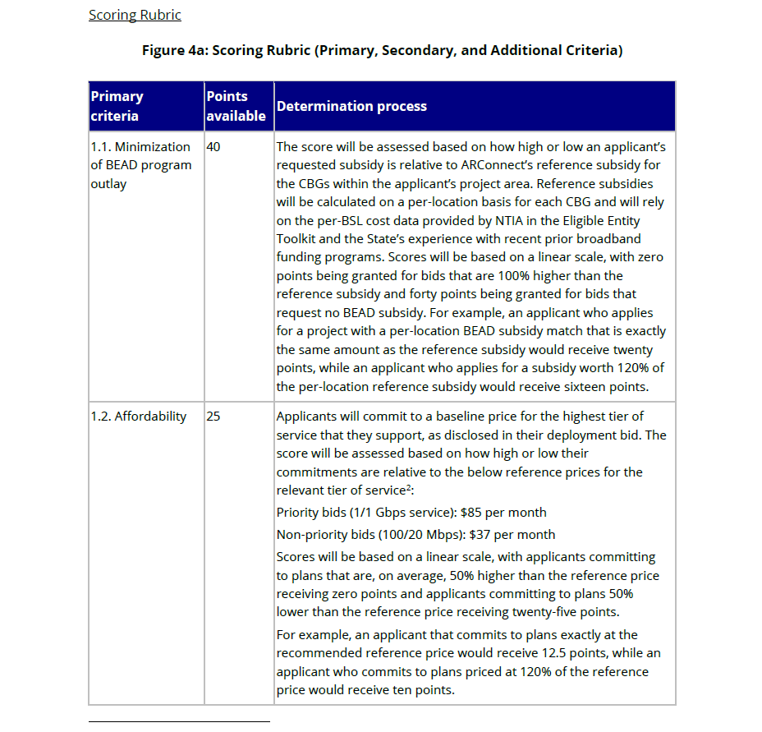
Tranche-3 applications are scored and adjudicated after applicants have submitted them
Start here: Results from Tranche-2 and the Partial Award Eligible process are posted in the portal
Sample screenshot of Scoring Rubric from Applicant Primer Section 3
Applicants may choose to submit new bids in Tranche-3
Total Tranche-3 points: 95
Zero bid CBG distinction is no longer relevant and does not need to be scored
ARConnect scores bids according to the Scoring Rubric (except for inclusion of zero bid CBGs)
ARConnect completes deconfliction and adjudication according to the Tranche-3 rules
ARConnect notifies applicants of adjudication results through Grantor Portal
Applicant action
ARConnect action
Notes:
So, just as in T1 and T2, applicants will submit bids through the applicant portal in Tranche-3 for a requested subsidy amount to serve a particular project area.
These applications will be then be scored using the scoring rubric, just as they were in T1 and T2, before finally being deconflicted and given an adjudication result
Again, please note that the maximum number of points available in Tranche-3 is 95, as the inclusion of zero bid cbg criteria is no longer relevant and does not need to be scored
NEXT

Slide 10
Restrictions, eligibility, and rules of adjudication for Tranche-3
Project area restrictions
All CBGs that remain at the beginning of Tranche-3 are available for bidding
A bid's project area may only include a single CBG¹
An applicant may bid on a CBG up to 3 times
Tranche-3 rules of adjudication
Rule #1: Preliminary selections will have the highest score of the highest technology type or are the sole bidder on their project area
Technology type eligibility
In Tranche-3, all technology type categories – Priority, Non-Priority, and Alternative – are eligible for preliminary selection
1. With the exception of "donut" CBGs, where bidders must bid for both the outer and inner CBGs together in the case where one sits inside the other
Notes:
With that, there are a few key items to note for Tranche-3 around restrictions, eligibility, and the rules of adjudication
The first is around project area restrictions, which we touched on earlier, but just want to make sure these are clear
In Tranche-3, all remaining eligible CBGs – that is CBGs that were not selected in T1, T2, or the PAE outreach process – will be available for bidding. This is true for all applicants, regardless of your T1 and T2 results
In Tranche-3, a bid's project area may only include a single CBG – so it is one CBG per bid. The only exceptions are the "donut" CBGs, where one CBG sits inside of another. In those cases, you would bid on both the outer and inner CBG together
And similar to previous Tranches, you will be able to bid on a particular CBG up to 3x
For the adjudication of Tranche-3, there will only be one rule in effect – which is that preliminary selections will have the highest score of the highest technology type or are the sole bidder on their project area.
We will look at some examples of this in just a moment
And finally, to reiterate, in Tranche-3, all technology type categories – so Priority, Non-priority, and Alternative – are eligible for preliminary selection
NEXT

Slide 11
Tranche-3 deconfliction scenarios and adjudication results
Tranche-3 rules of adjudication
Rule #1: Preliminary selections will be the highest score of the highest technology type or are the sole bidder on their project area
Scenario 1: All tech types
Scenario 2: Non-Priority and Alt tech
Scenario 3: Alt tech only
Bid | Tech type | Score
A | Priority | 70
B | Priority | 60
C | Non-Priority | 80
D | Non-Priority | 70
E | Alternative | 85
Bid | Tech type | Score
A | Non-Priority | 80
B | Non-Priority | 70
C | Non-Priority | 60
D | Alternative | 85
E | Alternative | 80
Bid | Tech type | Score
A | Alternative | 80
B | Alternative | 79
C | Alternative | 75
D | Alternative | 60
E | Alternative | 55
Preliminarily Selected bid
Notes:
Finally, I wanted to end today by providing a few examples of deconfliction in Tranche-3
As we just mentioned, there is only one rule of adjudication in Tranche-3, which says that preliminary selections will be the highest score of the highest technology type or are the sole bidder on their project area
So we have three scenarios
In each scenario, we have five overlapping bids – A, B, C, D, and E, and for each bid we list their technology type and their score
In Scenario 1, we have a mix of all 3 technology types: priority, nonpriority, and alternative
In Scenario 2, we have a mix of non priority and alternative
And in Scenario 3, we only have alternative bids
In each scenario, we have ordered the bids to reflect the highest score of the highest tech type, meaning that the highest ranked bid will be the one that is preliminarily selected
So in scenario 1, bid A wins because, of the bids it overlaps with, it has the highest score (70) of the highest tech type (priority). Even though there are higher scoring bids, they are of a lower technology type, and therefore won't be selected
In Scenario 2, where there are a mix of non priority and alternative technology bids, we see the same thing. Bid A will be selected because it is the highest scoring bid of the highest tech type of the bids it overlaps with
Finally, in T3, all bids have the same technology type, which in this case is alternative. In this scenario, the highest score would win
One last thing to call attention to – so this means that all CBGs that receive a bid in Tranche-3 will be awarded
That concludes our review of Tranche-3 and now I will cover this week's FAQ

Slide 12
Agenda
Agenda
 | What are the application submission rules for Tranche-3?
 | What CBGs are available for bidding in Tranche-3?
 | How will applications be preliminarily selected in Tranche-3?
 | Resources and reminders
1
2
3
4

Slide 13
ARConnect will only provide technical support during the Tranche-2 application window
If you are experiencing a technical issue with the portal, please reach out to argrants@mbakerintl.com
If you have questions regarding the application and/or the Arkansas BEAD process, we encourage you to reference the following resources housed on the Arkansas BEAD Webpage:
WORK IN PROGRESS
 | IPvII
 | Applicant Primer
 | Applicant Portal User Guide
 | TA Session materials and FAQ documents (found under "Technical Assistance" dropdown)

Slide 14
1
You should submit your strongest applications, but keep in mind your service commitment if selected
Key reminders for Tranche-2
2
You must complete any revisions and submit within the 2-week application period. No exceptions
WORK IN PROGRESS
3
Carried Forward applications will automatically be resubmitted at the close of the application window, but you are encouraged to manually submit. Any unsubmitted modifications will not be captured
4
The applicant portal opens on Tuesday, February 25th at 12:00 p.m. and closes on Tuesday, March 11th at 6:00 p.m.

